Slide 1
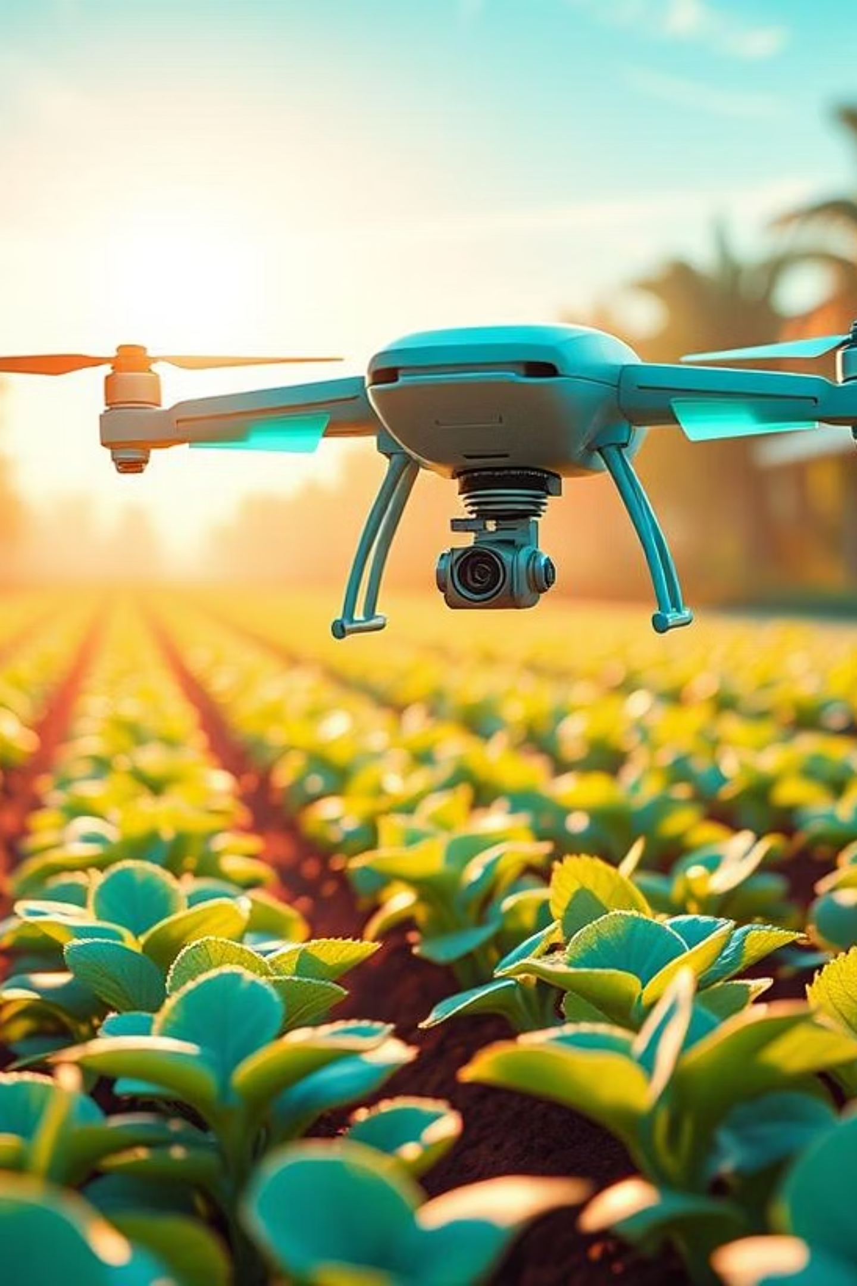
Agri Smart:
Enhancing Agricultural Decisions with ML-Based Crop Prediction
Presented By:
V. Pavani
M. Bhargav Vijay

Slide 2



INTRODUCTION
Agriculture plays a vital role in our lives, and choosing the right crop to grow is very important for farmers. However, selecting the best crop is not always easy. It depends on many factors like soil nutrients, pH level, temperature, humidity, and rainfall.
Many farmers still rely on experience or guesswork, which can lead to poor crop choices, low yield, and financial loss.
Our project aims to solve this problem using Machine Learning. By analyzing the data from soil and environmental conditions, our model can predict the most suitable crop for a given area. This helps farmers make smart, data-based decisions and improve productivity.
The Challenge
Our Solution
Impact & Importance
Farmers struggle with crop selection due to dynamic environmental conditions, leading to suboptimal yields and financial loss. Traditional farming depends more on guesswork than on actual data.
We apply machine learning to analyze soil nutrients and weather data (N, P, K, Ph, rainfall) to recommend the most suitable crop, ensuring data-driven decisions for optimal growth.
This model helps farmers grow more crops, use resources like water and soil more efficiently, and supports food availability for everyone. It also encourages eco-friendly farming and solves important farming problems in a better way.

Slide 3
PROBLEM STATEMENT
Define the Task Clearly
The task is a multiclass classification problem.
The model predicts the most suitable crop category based on input features like nitrogen (N), phosphorus (P), potassium (K), temperature, humidity, pH, and rainfall.
Each input sample is assigned to one class (crop) from a set of predefined crop types.
Objectives of the Model
To build a machine learning model that can accurately recommend the best crop for a given set of environmental and soil conditions.
To improve farming decisions, enhance crop yield, and reduce resource wastage.
To support precision agriculture and make farming smarter and more sustainable.
Constraints or Assumptions
The model assumes that the input data is accurate and up-to-date (e.g., real values for soil nutrients, rainfall, etc.).
It works best within the range of crops and environmental conditions represented in the training dataset.
It may not perform well if used for completely new regions or unseen crops outside the training scope.

Slide 4
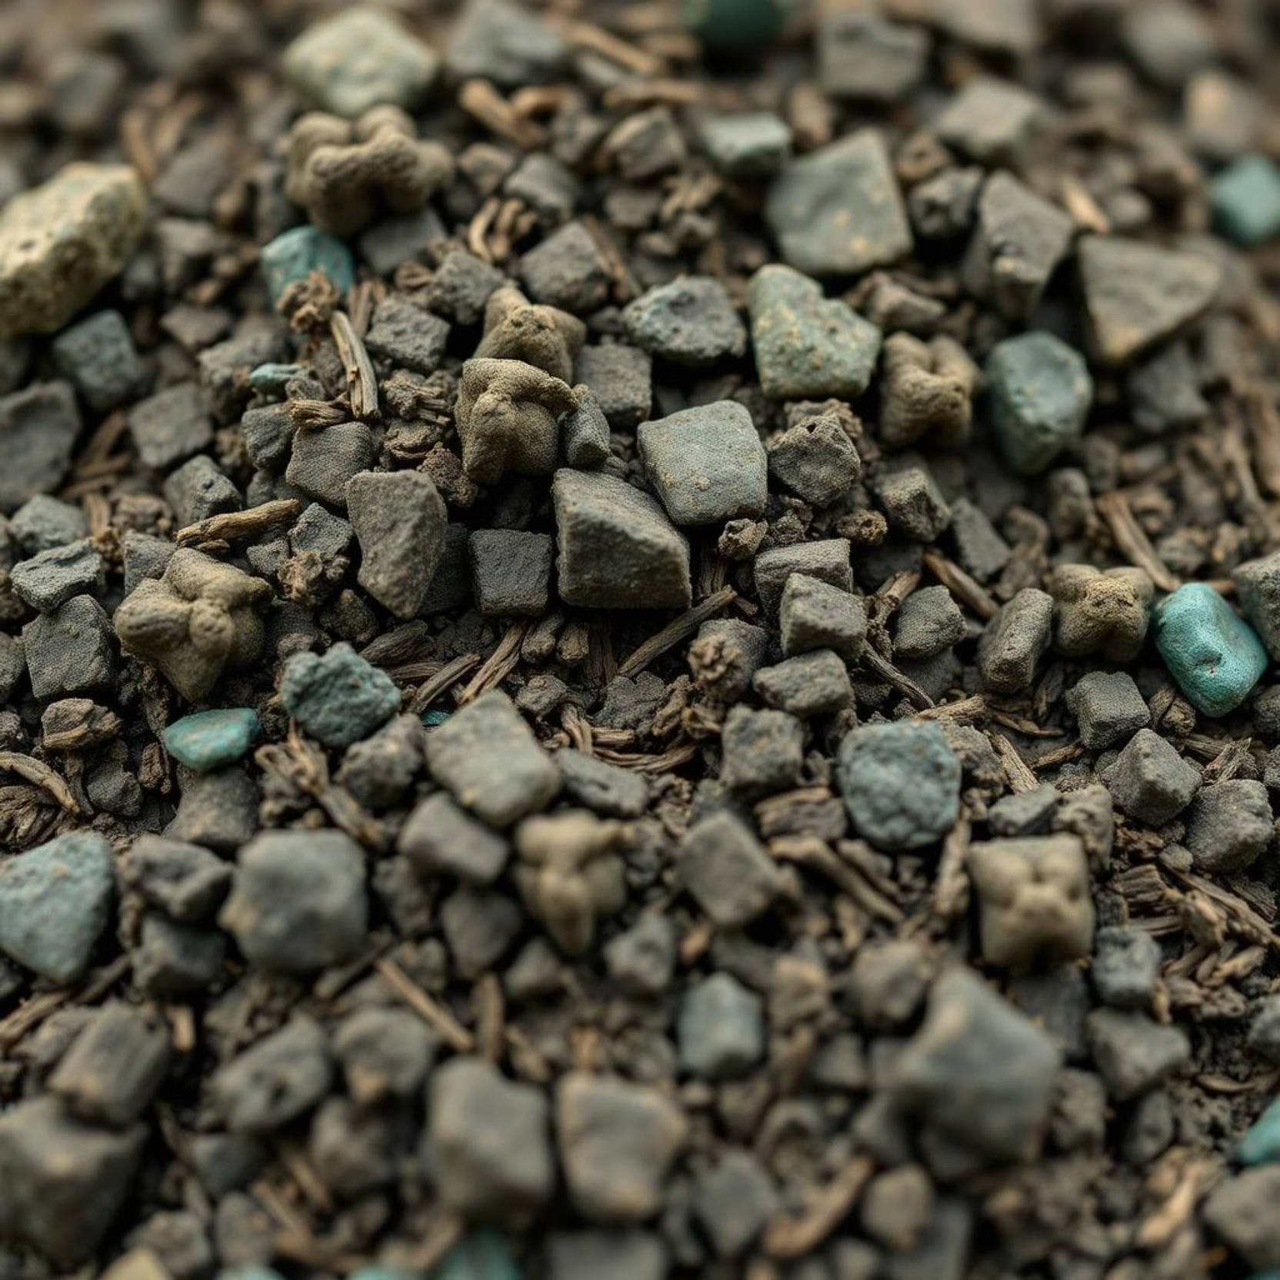
DATA COLLECTION & UNDERSTANDING
Source of Data:
The dataset used for crop prediction is publicly available on platforms like Kaggle or other agriculture research datasets. It contains real-world data on soil nutrients and environmental conditions for various crops.
Size: Typically, over 2,200 rows with 8 distinct columns, providing a robust foundation for analysis.
Key Features: Nitrogen (N), Phosphorus (P), Potassium (K), Temperature, Humidity, pH value, Rainfall, and the target Crop Label.
Challenges in Data Handling
Missing Values: The dataset must be checked and cleaned before training models.
Imbalanced Classes: Some crops appear more frequently than others, which may bias the model.
Outliers: Extremely high or low values in features like rainfall or pH can affect model accuracy.
Generalization: The model might not perform well in regions or seasons not covered in the dataset.

Slide 5
Selected important features like N, P, K, temperature, humidity, pH, rainfall.
DATA PREPROCESSING
Data Cleaning
Feature Engineering
Selected important features like N, P, K, temperature, humidity, pH, rainfall.
Applied Label Encoding to convert the target column (crop type) into numeric format.
Created a cleaner, model-ready dataset by transforming and selecting features effectively.
Handled missing values using the median strategy
Detected and treated outliers using the IQR (Interquartile Range) method.
Ensured dataset quality by removing noise and inconsistencies.
Data Transformation
Train/Test Split & Validation
Applied Standard Scaler to N, temperature, pH, and rainfall for normalization.
Applied Min Max Scaler used on P
Applied Robust Scaler on K, humidity, and rainfall to handle outliers.
Label Encoding used to convert the target column (crop type) into numeric format.
Used an 80/20 train-test split to divide the dataset for training and testing.
Ensured fair evaluation of model performance on unseen data without overfitting.

Slide 6
MODEL SELECTION & JUSTIFICATION
Algorithm Considered
Baseline Model Comparison
Logistic Regression
Random Forest was used as a baseline model because it's simple and fast.
We then compared all other models against it.
Models like KNN and SVM outperformed the baseline significantly.
Decision Tree
Random Forest
K-Nearest Neighbors (KNN)
Support Vector Machine (SVM)
No. | Model Name | Train Acc | Test Acc | Total Acc | Cross-Entropy
1 | Logistic Reg. | 0.8630 | 0.8180 | 0.85 | 0.4260
2 | Decision Tree | 0.9301 | 0.9341 | 0.93 | 0.3742
3 | Random Forest | 0.9244 | 0.9273 | 0.92 | 0.1034
4 | Ada Boost | 0.9352 | 0.9386 | 0.92 | 1.3193
5 | XG Boost | 0.9437 | 0.9364 | 0.93 | 1.3804
6 | Grad. Boost | 0.9517 | 0.9500 | 0.95 | 0.5061
7 | KNN | 0.9773 | 0.9523 | 0.95 | 0.0823
8 | SVM | 0.9563 | 0.9477 | 0.94 | 0.1173
XG Boost
Ada Boost
Gradient Boost
Justification for Final Choice
After comparing models, we found that Random Forest, Support Vector Machine, K-Nearest Neighbours performed the best in terms of:
High testing accuracy
Low cross-entropy loss
Balanced performance across classes

Slide 7
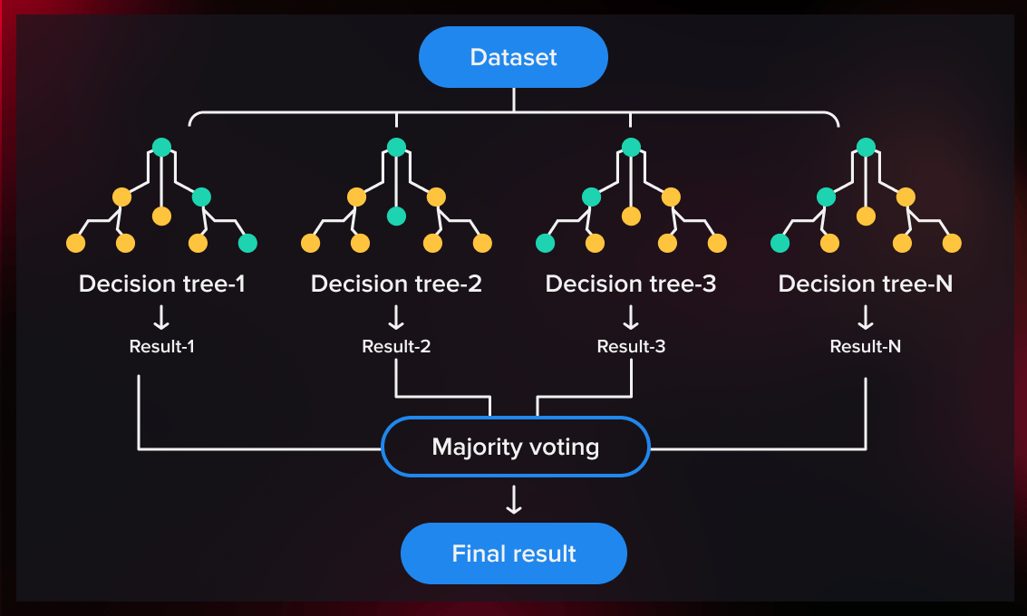
MODEL TRAINING & OPTIMIZATION
Training Process
In this project, we used the Random Forest algorithm to train our crop prediction model. The training started by splitting the dataset into training and testing sets. Random Forest then created multiple decision trees using random samples of the data and a random subset of features for each tree.
Each tree learned to predict the crop based on input features like N, P, K, temperature, humidity, pH, and rainfall. Once all trees were trained, they made predictions, and the final result was decided by majority voting.
Hyperparameter Tuning
For the best-performing model (Random Forest), we fine-tuned hyperparameters such as:
max_depth, min_samples_split, min_samples_leaf, max_features, class_weight,bootstrap, criterion, random_state.
Cross-Validation
Cross-validation is a method used to test how well a machine learning model works on new data. Instead of testing the model only once, the data is split into parts and the model is trained and tested multiple times. This helps get a more accurate and reliable result. It also helps in choosing the best model and tuning its parameters.

Slide 8
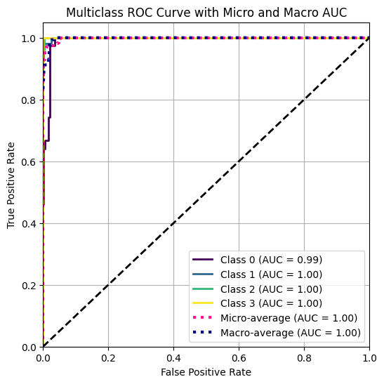
EVALUATION METRICS & PERFORMANCE
Key Metrics Utilized
Accuracy: Overall correctness of predictions.
Precision: Proportion of true positive predictions.
Recall: Ability to identify all relevant instances.
F1-Score: Harmonic mean of precision and recall.
Confusion Matrix: Detailed breakdown of classification results.
AUC-ROC: Used for checking the model’s ability to distinguish.
Model Performance for training data
Test Accuracy: 92.73%
Cross-Entropy Loss: 0.1653 (very low – shows confident predictions)
Precision, Recall, F1-Score: All around 92–93%, indicating strong overall performance.
Confusion Matrix: Very few misclassifications, high correct predictions across crop classes.
Performs well in multi-class classification tasks.

Slide 9
RESULTS
Model Performance
Random Forest was the most accurate and consistent model.
It achieved the lowest cross-entropy loss, indicating strong predictive reliability.
Feature Influence
The most significant features for crop prediction were:
Nitrogen (N), Phosphorus (P), Potassium (K)
Temperature, Humidity, pH, and Rainfall
These features contributed substantially to accurate model outputs.
Model Comparison
Ensemble models, particularly Random Forest and Boosting methods, outperformed simpler models.
They demonstrated higher accuracy, better stability, and improved generalization.
Impact of Preprocessing
Proper data preprocessing and hyperparameter tuning significantly improved model performance.
These steps helped reduce errors and enhance overall prediction quality.

Slide 10
DISCUSSION
Strengths of the Model
Delivered high prediction accuracy with consistent results across tests.
Handled noisy and outlier data effectively, maintaining robustness.
Scalable to include more crops, regions, or updated datasets.
Provided meaningful feature importance insights for agricultural decision-making.
Interpretability and Insights
Feature importance helped identify which environmental and soil factors are most critical.
Enabled better understanding of crop suitability across varying conditions.
Limitations of the Study
The dataset may not fully represent all regional or seasonal variations.
The model does not incorporate real-time data such as live weather or pest alerts.
May require retraining or fine-tuning for application in new geographic areas.

Slide 11
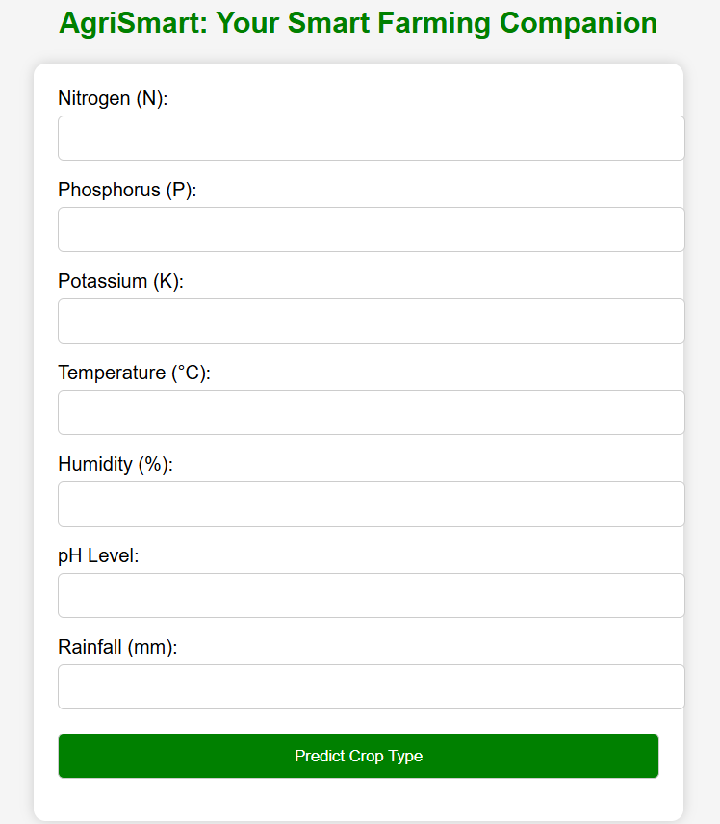
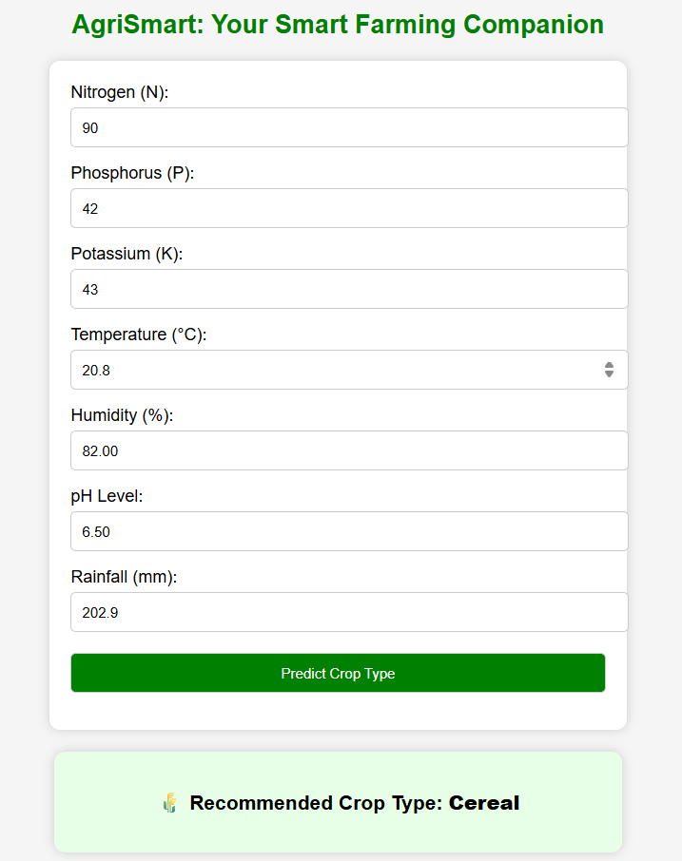
DEPLOYMENT
The model is deployed using the Flask web framework with a simple user interface.
Users input values for N, P, K, temperature, humidity, pH, and rainfall..
USER INTERFACE
Predicted Crop Display
These inputs are processed and passed to a trained Random Forest model for prediction.
The application displays the recommended crop based on model output in real time

Slide 12
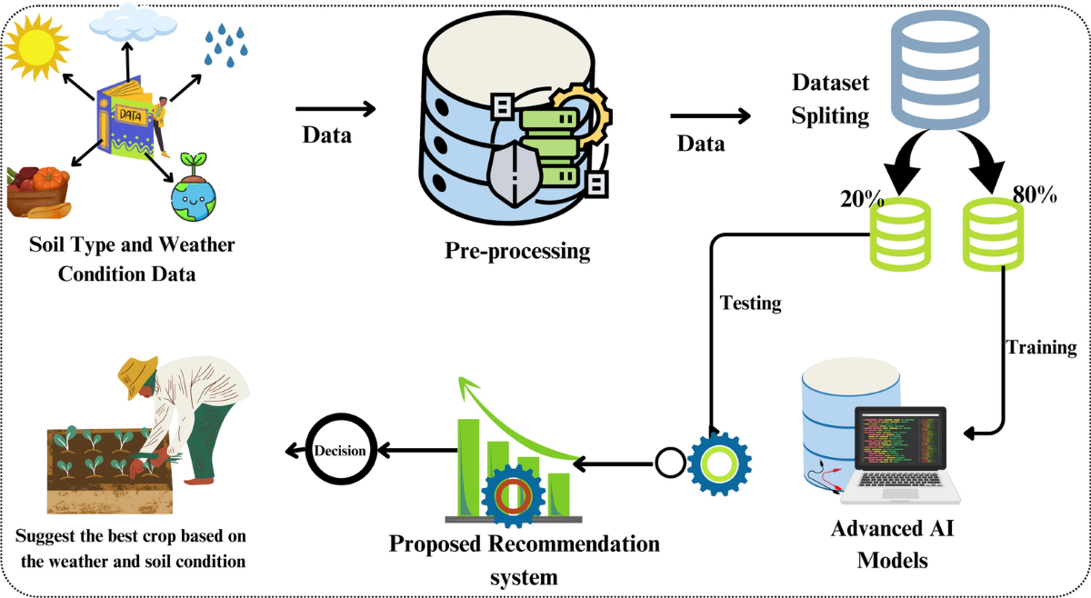
CONCLUSION
Summary of Outcomes
In this project, we developed a crop prediction system using multiple machine learning models. Among all the models tested, Random Forest provided the highest performance in terms of accuracy and robustness on the test dataset. It effectively handled the multiclass classification problem and showed strong generalization capabilities.
Lessons Learned
How to use machine learning to predict the best crop based on soil and weather data.
Random Forest is a powerful model that gives high accuracy for crop prediction.
Data cleaning, feature selection, and evaluation are key to building a good model.
Crop prediction systems can support smart farming and help farmers make better choices.
Future Work and Possible Improvements
Add real-time weather and satellite data to improve prediction accuracy.
Build a mobile or web app so farmers can easily use the model.
Include pest and disease prediction for better crop health management.

